Slide 1

APPLIANCE AUTOMATION USING
HAND GESTURES
SUBMITTED IN THE PARTIAL FULFILLMENT FOR THE AWARD OF THE DEGREE OF
BACHELOR OF ENGINEERING
IN
ARTIFICIAL ENGINEERING AND MACHINE LEARNING
SUBMITTED BY:
PRANAY REDDY(18BCS6100)
CHITRANG JUNEJA(18BCS6115)
SEJAL GULATI(18BCS6116)
LAYBA SHAIKH(18BCS6117)
SACHIN KAUSHIK(18BCS6119)
UNDER THE SUPERVISION OF:
MR. SOMSIRSA CHATTERJEE
01

Slide 2
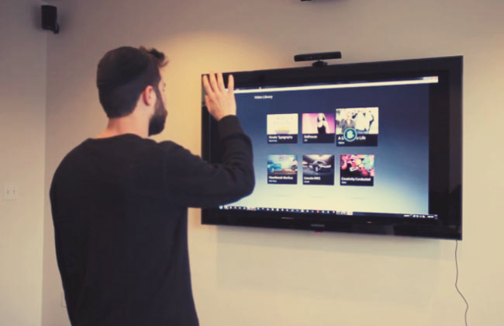

OUTLINE
INTRODUCTION TO PROJECT
PROBLEM FORMULATION
OBJECTIVES OF THE WORK
METHODOLOGY USED
RESULTS AND OUTPUTS
CONCLUSION
FUTURE SCOPE
REFERENCES
02

Slide 3

Introduction to Project
PROBLEM DEFINITION
IN EVERYDAY LIFE, PHYSICAL GESTURES ARE A POWERFUL MEANS OF COMMUNICATION. A SET OF PHYSICAL
GESTURES MAY CONSTITUTE AN ENTIRE LANGUAGE, AS IN SIGN LANGUAGES. A SYSTEM WHICH UTILIZES SENSOR
FUSION, LOW POWER DIGITAL COMPONENTS, AND SMARTPHONE CELLULAR CAPABILITIES CAN EXTEND THE USEFULNESS
OF SUCH A SYSTEM TO ALLOW GREATER ADAPTIVITY FOR PATIENTS WITH VARIOUS NEEDS, BE IT A PERSON WITH
PHYSICAL DISABILITY OR A BLIND PERSON. A PRIMARY GOAL OF GESTURE RECOGNITION RESEARCH IS TO CREATE A
SYSTEM WHICH CAN IDENTIFY SPECIFIC HUMAN GESTURES AND USE THEM TO CONVEY INFORMATION OR FOR
DEVICE CONTROL. INTERFACE WITH COMPUTERS USING GESTURES OF THE HUMAN BODY, TYPICALLY HAND
MOVEMENTS.
03

Slide 4
Introduction to Project
PROJECT OVERVIEW/SPECIFICATIONS
● THIS PROJECT MAINLY CONSISTS OF A HAND GESTURE RECOGNITION SECTION AND A CONTROL HUB
SECTION. THE HAND GESTURE RECOGNITION SECTION CONSISTS OF A GYROSCOPE AND ACCELEROMETER,
A MICROCONTROLLER AND A TRANSMITTER.
● THE CONTROL HUB CONSISTS OF A RECEIVER, A
MICROCONTROLLER, A RELAY SWITCH AND A BLUETOOTH MODULE.
● WE WILL BE MAKING USE OF PROTEUS, ΜVISION IDE, AN ANDROID APPLICATION, AND DEEP
LEARNING IN THIS PROJECT.
● WE WILL USE DEEP LEARNING AND DIGITAL IMAGE PROCESSING TO TAKE THOSE GESTURES AS INPUT
AND PROCESS THEM AND GIVE RESPECTIVE OUTPUT AS THE TASK.
● WE WILL USE PYTHON TO DESIGN UI.
● PYTHON PROVIDES SEVERAL DIFFERENT OPTIONS FOR WRITING GUI BASED PROGRAMS
04

Slide 5
Introduction to Project
HARDWARE AND SOFTWARE SPECIFICATION
ARDUINO UNO
5 mm LED
10K OHM PRESET
7805 AND 7812 VOLTAGE REGULATORS.
12 V RELAY.
10K OHM PRESET
TRANSISTOR (BC547)
BULB HOLDER
TWO PIN PLUG
APDS-9960 GESTURE SENSOR
PROTEUS
KEIL ΜVISION IDE
SOFTWARE
HARDWARE
ANDROID APPLICATION INSTALLED ON ANDROID DEVICE
PYTHON
05

Slide 6
Problem Formulation
THIS PROJECT MAINLY CONSISTS OF A HAND GESTURE RECOGNITION SECTION AND A CONTROL HUB SECTION. THE
HAND GESTURE RECOGNITION SECTION CONSISTS OF A MICROCONTROLLER AND A TRANSMITTER. THE CONTROL HUB
CONSISTS OF A RECEIVER, A MICROCONTROLLER, A RELAY SWITCH AND A BLUETOOTH MODULE.
WE WILL DEVELOP SUCH A SYSTEM AS A BLUETOOTH ENABLED GLOVE DEVICE WHICH COMMUNICATES WITH A
REMOTE WEB SERVER TO CONTROL SMART-DEVICES WITHIN THE HOME.
THE BASIC PURPOSE OF THIS SYSTEM IS TO CONTROL DIFFERENT ELECTRONIC DEVICES WITH THE HELP OF HAND
MOVEMENT. THUS, THIS SYSTEM WILL WORK AS A REMOTE CONTROL FOR OPERATING DIFFERENT ELECTRONIC
DEVICES PRESENT IN DAILY USE.
06

Slide 7

1) USERS CAN USE SIMPLE HAND GESTURES IN ORDER TO CONTROL THE APPLIANCES.
2) PHYSICALLY IMPAIRED PEOPLE WOULD NOT REQUIRE EXTRA HELP IN ORDER TO MAKE USE OF HOME
APPLIANCES.
3) WE WILL BE DEVELOPING SUCH A SYSTEM AS A BLUETOOTH ENABLED GLOVE DEVICE WHICH
COMMUNICATES WITH A REMOTE WEB SERVER TO CONTROL SMART-DEVICES WITHIN THE HOME.
4) THE DEVICE WILL HELP THE AGED PERSONS TOO
Objectives
07

Slide 8
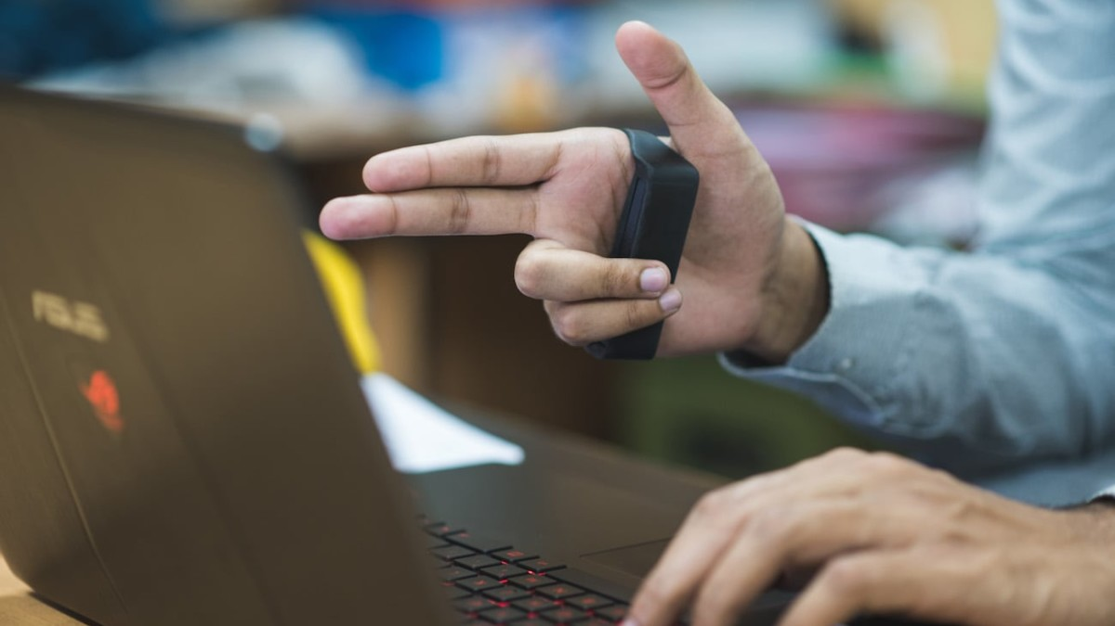

Methodology Used
In this project we are going to make such an application using Bluetooth enabled glove devices
which communicates with a remote web server to control smart-devices within the home. The
hand gesture recognition section consists of a microcontroller and a transmitter. The control
hub consists of a receiver, a microcontroller, a relay switch and a Bluetooth module.
We will be designing a Chatbot that will serve as a frontend in order to guide the user and
interact with him.
08

Slide 9
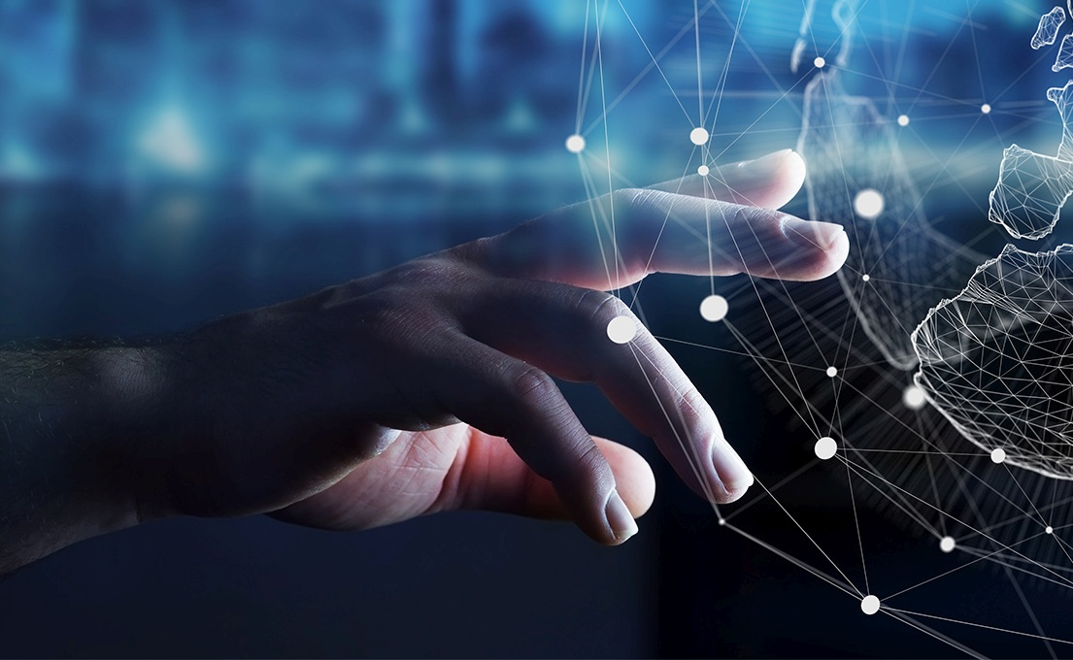
Then the gesture the user makes, will be captured and recognized and it will be converted into
binary form in order and will be sent to the bluetooth module.
We will be making use of Deep learning and Machine learning collectively.
09

Slide 10
Results and Outputs
IN THIS PROJECT WE MADE AN APPLICATION USING BLUETOOTH ENABLED GLOVE DEVICES
WHICH COMMUNICATES WITH A REMOTE WEB SERVER TO CONTROL SMART-DEVICES WITHIN THE HOME. THE
HAND GESTURE RECOGNITION SECTION CONSISTS OF A MICROCONTROLLER AND A TRANSMITTER. THE CONTROL
HUB CONSISTS OF A RECEIVER, A MICROCONTROLLER, A RELAY SWITCH AND A BLUETOOTH MODULE.
WE WILL BE DESIGNING A CHATBOT SERVES AS A FRONTEND IN ORDER TO GUIDE THE USER AND
INTERACT WITH HIM.
THEN THE GESTURE THE USER MAKES, GETS CAPTURED AND RECOGNIZED AND THEN CONVERTED INTO
BINARY FORM IN ORDER AND WILL BE SENT TO THE BLUETOOTH MODULE.
WE USED DEEP LEARNING AND MACHINE LEARNING COLLECTIVELY IN THIS.
10

Slide 11
Results and Outputs
1) USERS CAN USE SIMPLE HAND GESTURES IN ORDER TO CONTROL THE APPLIANCES.
2) PHYSICALLY IMPAIRED PEOPLE WOULD NOT REQUIRE EXTRA HELP IN ORDER TO MAKE USE OF HOME
APPLIANCES.
3) WE MADE SUCH A SYSTEM AS A BLUETOOTH ENABLED GLOVE DEVICE WHICH
COMMUNICATES WITH A REMOTE WEB SERVER TO CONTROL SMART-DEVICES WITHIN THE HOME.
4) THE DEVICE CAN HELP THE AGED PERSONS TOO
11

Slide 12
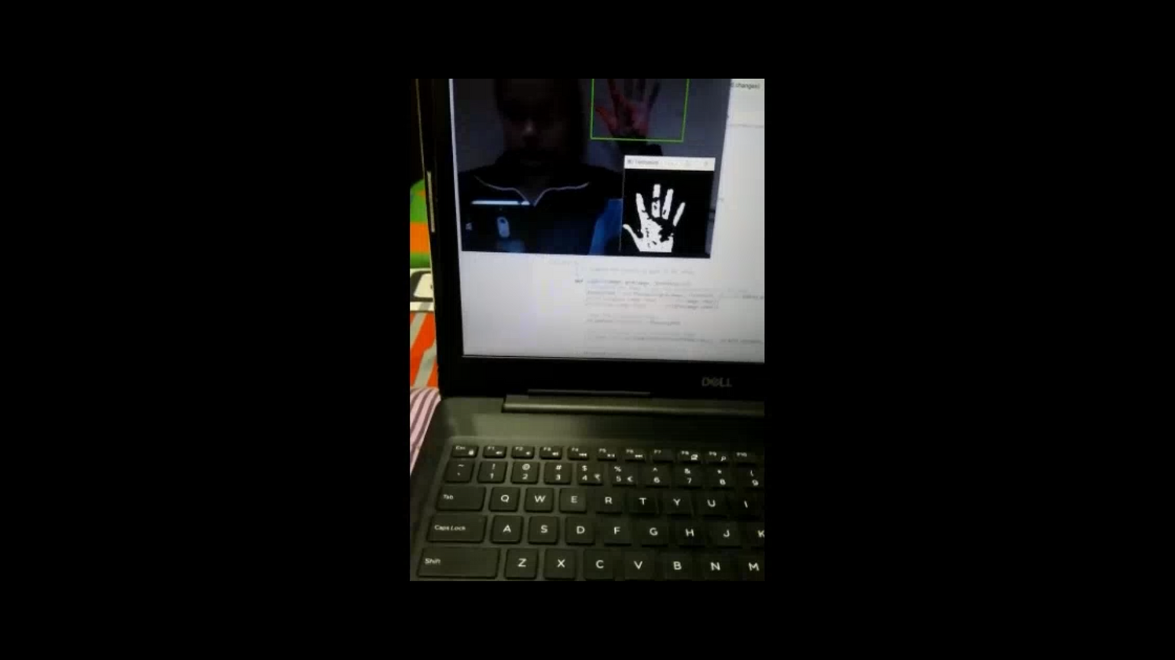

Results and Outputs
working
12

Slide 13
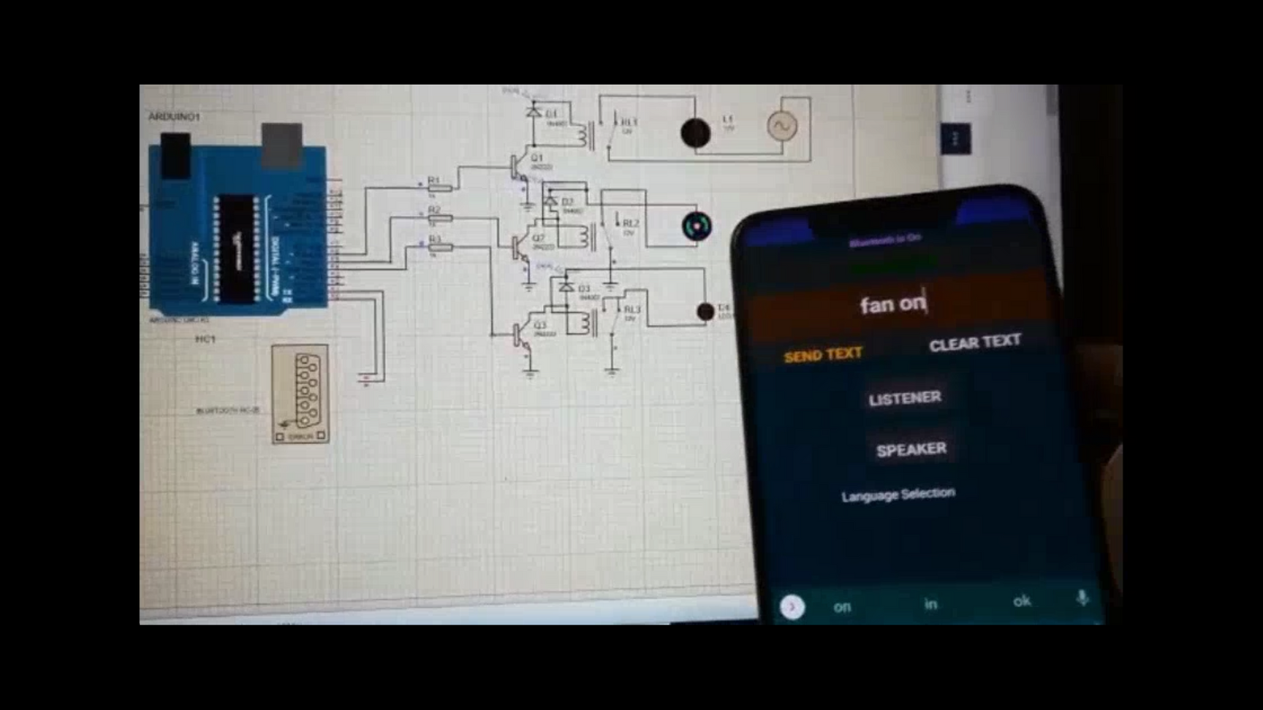
Results and Outputs
working
13

Slide 14
Results and Outputs
working
14
LINK- https://drive.google.com/file/d/1VQELtaM_GtTPlktDZDuL9R08DTxzdZQI/view?usp=sharing

Slide 15

Conclusion
THE GOAL OF OUR PROJECT WAS TO DESIGN A USEFUL AND FULLY FUNCTIONAL REAL-WORLD PRODUCT THAT EFFICIENTLY TRANSLATES THE MOVEMENT OF HAND TO ELECTRICAL SIGNALS THAT CAN CONTROL THE HOME APPLIANCES. OUR MOTIVATION IS TO HELP DIFFERENTIALLY ABLE PEOPLE TO CONTROL THE ELECTRICAL APPLIANCES MORE EASILY. THE GESTURE CONTROL AUTOMATION SYSTEM USES A GLOVE TO RECOGNIZE THE HAND POSITIONS AND OUTPUTS ONTO A DISPLAY AND CONTROL THE ELECTRONIC DEVICES LIKE FAN, LIGHT, MUSIC SYSTEM ETC. THE SYSTEM WAS TRAINED AND TESTED FOR MULTIPLE USERS SUCCESSFULLY. THE PROPOSED SYSTEM HAS THE ADVANTAGE OF LOW POWER CONSUMPTION, SIMPLE HARDWARE AND HAND GESTURES, EASY TO OPERATE AND USER FRIENDLY
15

Slide 16
Future Scope
THE FUTURE GOAL IS TO MAKE THIS APPLICATION MORE ADVANCED IN ORDER TO HELP PHYSICALLY DISABLED/
IMPAIRED PEOPLE.
THE OBJECTIVE OF THIS PROJECT IS TO DEVELOP SUCH A SYSTEM WHICH WILL HELP PHYSICALLY CHALLENGED
PEOPLE TO CONTROL HOME ELECTRONIC DEVICES BY HAND GESTURES. IN FUTURE WIRELESS BLUETOOTH
TECHNOLOGY IS ALSO USED FOR HOME AUTOMATION FOR THE PHYSICALLY IMPAIRED
16

Slide 17
References
[1] Mokhar M. Hasan, Pramod K. Mishra, (2012) ―Features Fitting using MultivariateGaussian Distribution for Hand Gesture Recognition‖,
International Journal of Computer Science & Emerging Technologies IJCSET, Vol. 3(2).
[2] Mokhar M. Hasan, Pramod K. Mishra, (2012). ―Robust Gesture Recognition Using Gaussian Distribution for Features Fitting‘, International Journal
of Machine Learning and Computing, Vol. 2(3).
[3] Mokhtar M. Hasan, Pramoud K. Misra, (2011). ―Brightness Factor Matching For Gesture Recognition System Using Scaled Normalization‖,
International Journal of Computer Science & Information Technology (IJCSIT), Vol. 3(2).
[4] V. S. Kulkarni, S.D.Lokhande, (2010) ―Appearance Based Recognition of American Sign Language Using Gesture Segmentation, International
Journal on Computer Science and Engineering (IJCSE), Vol. 2(3), pp. 56
[5] E. Stergiopoulou, N. Papamarkos. (2009). ―Hand gesture recognition using a neural network shape fitting technique,Elsevier Engineering
Applications of Artificial Intelligence, vol. 22(8), pp. 1141– 1158, doi: 10.1016/j.engappai.2009.03.008 0-565.
17

Slide 18
References
[6] Xingyan Li. (2003). ―Gesture Recognition Based on Fuzzy C-Means Clustering Algorithm‖, Department of Computer Science. The University of
Tennessee Knoxvill.
[7] Simei G. Wysoski, Marcus V. Lamar, Susumu Kuroyanagi, Akira Iwata, (2002). ―A Rotation Invariant Approach On Static-Gesture Recognition
Using Boundary Histograms And NeuralNetworks, IEEE Proceedings of the 9
th International Conference on Neural Information
Processing, Singapura.
[8] Kouichi M., Hitomi T. (1999) ―Gesture Recognition using Recurrent Neural Networks ACM conference on Human factors in
computing systems: Reaching through technology (CHI '91), pp. 237-242. doi: 10.1145/108844.108900[13] Mahmoud E., Ayoub A., J¨org A., and
Bernd M., (2008). ―Hidden Markov Model-Based Isolated and Meaningful Hand Gesture Recognition‖, World Academy of Science, Engineering
and Technology 41.
[9] W. T. Freeman and Michal R., (1995) ―Orientation Histograms for Hand Gesture Recognition, IEEE International Workshop on Automatic Face and
Gesture Recognition.
[10] Mahmoud E., Ayoub A., Jorge A., and Bernd M., (2008). ―Hidden Markov Model-Based Isolated and Meaningful Hand Gesture Recognition,
World Academy of Science, Engineering and Technology 41.
18

Slide 19

Thankyou!

